Slide 1

Architectural Drafting + Planning
Kramer-Correia Construction

Slide 2


COURSE OUTLINE
LESSON 1
LESSON 3
LESSON 5
The role of
architects in
sustainable design
Environmental considerations in architectural planning
Case studies:
sustainable architectural designs
LESSON 2
LESSON 4
Principles of
efficient design
Technological
advancements in architectural drafting

Slide 3




Lesson one
THE ROLE OF ARCHITECTS IN SUSTAINABLE DESIGN
Definition of architectural drafting and planning
Exploring the responsibilities and challenges architects face
The impact of architectural decisions on energy efficiency and resource conservation

Slide 4

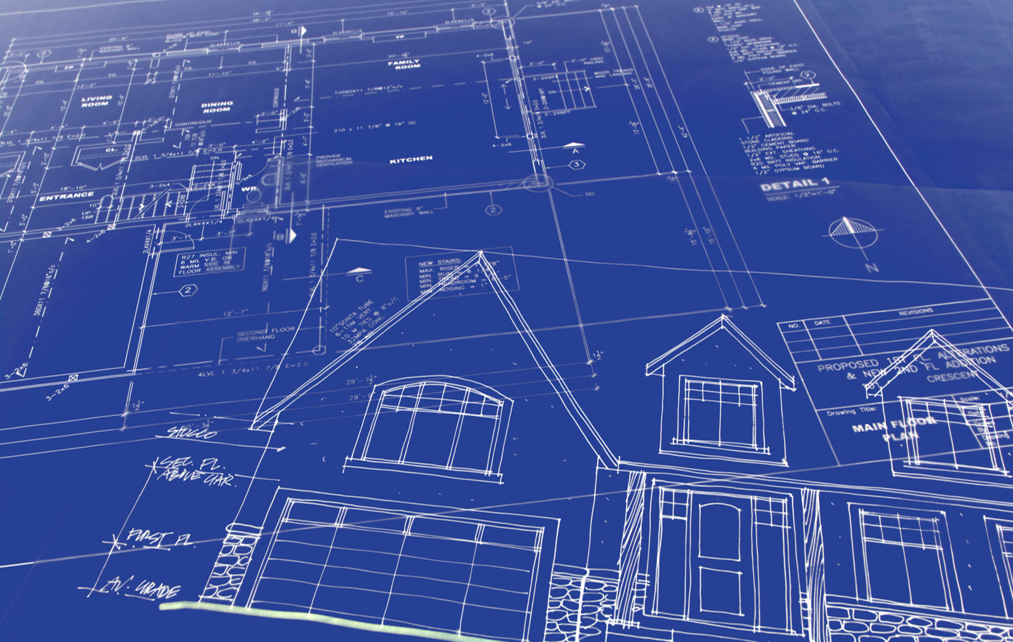
Lesson One
Architectural drafting and planning refer to the processes involved in creating detailed drawings, diagrams, and plans for the design, construction, and development of buildings and structures.
Architects bear significant responsibilities in the design and construction of buildings.
By incorporating sustainable design principles, architects can minimize the environmental impact of structures and promote efficient resource utilization.

Slide 5


Lesson two
The Principles of Efficient Design
Space planning
Functional layouts

Slide 6



Lesson three
ENVIRONMENTAL CONSIDERATIONS
Architects play a crucial role in implementing these practices to reduce the environmental impact of buildings.
Green building practices involve the integration of sustainable design strategies and the use of environmentally friendly materials throughout the entire architectural process.
Water conservation strategies can include the incorporation of efficient plumbing, rainwater collection, and landscape designs that require minimal irrigation.

Slide 7
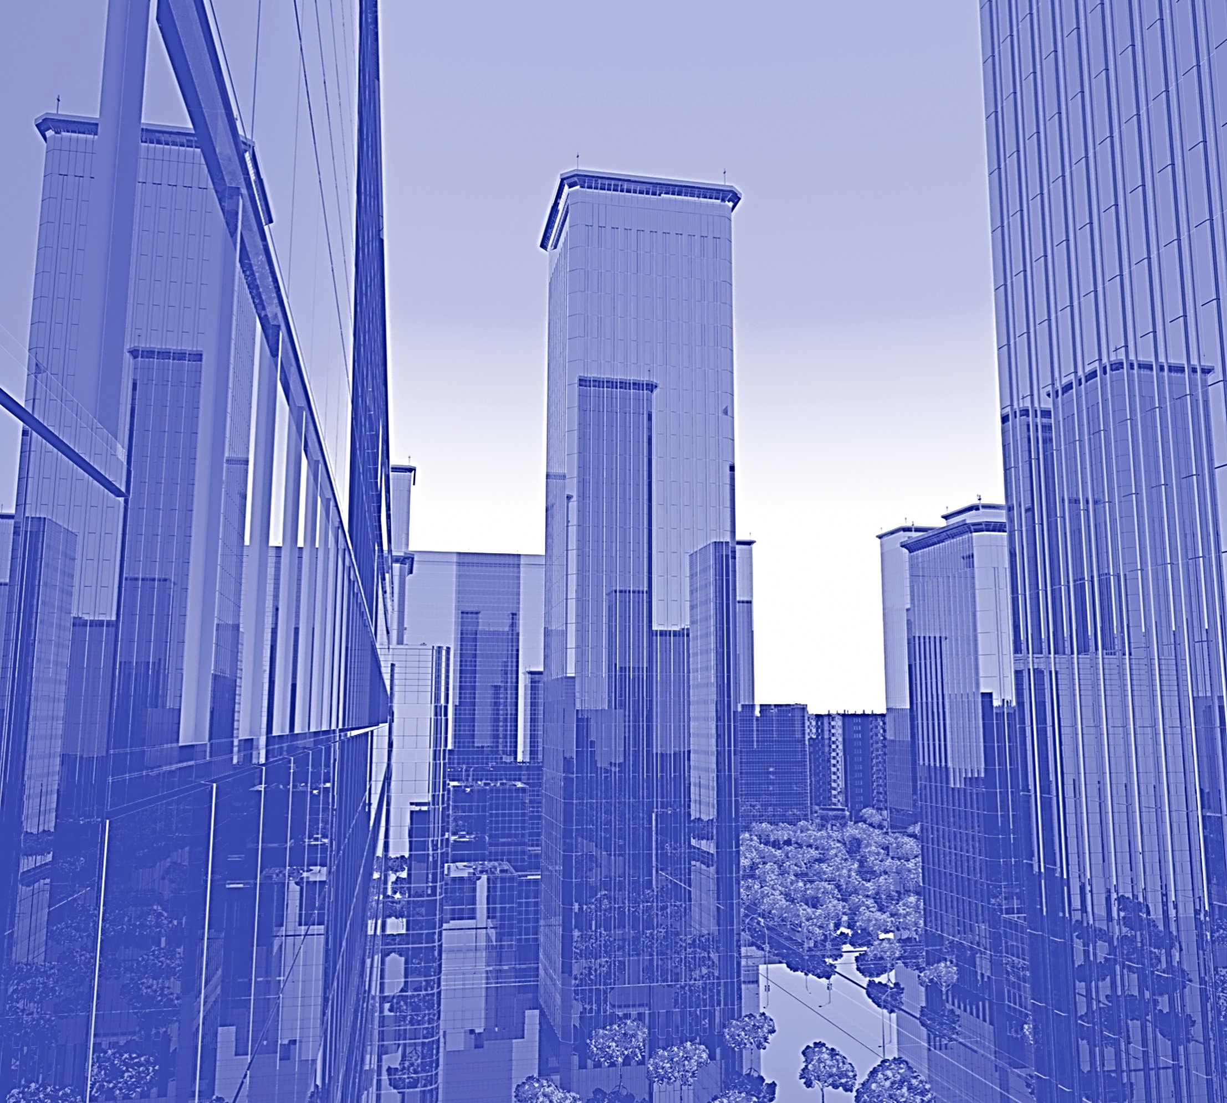
Lesson one summary
Significance of sustainable design in today's world
Exploring the responsibilities and challenges architects face
The impact of architectural decisions on energy efficiency and resource conservation

Slide 8
Course progress
Lesson 1.
Lesson 3.
Lesson 5.
Role of architects in sustainable design
Environmental considerations
Case studies
Lesson 2.
Lesson 4.
Principles of efficient design
Technological advancements

Slide 9




Course overview
Architects must navigate a multitude of challenges throughout the design process, like understanding client requirements, incorporating sustainable design principles, and collaborating with various stakeholders.
Balancing creativity with practicality and addressing the diverse needs of clients and users are constant challenges that architects must tackle to deliver successful architectural solutions.
By examining the importance of efficient design, environmental considerations, and technological advancements, we can understand how architects play a pivotal role in shaping the future of our built environment.
Architectural drafting involves creating precise and accurate two-dimensional (2D) or three-dimensional (3D) representations of architectural designs, while architectural planning encompasses the strategic considerations, spatial organization, and functional layout of a structure, taking into account factors such as aesthetics, building codes, safety regulations, and sustainability.

Slide 10

Join us next month
Join us next month as we uncover more key elements of architectural drafting and planning that contribute to the creation of sustainable, functional, and aesthetically pleasing structures.

Slide 11

Thank you
Kramer-Correia Construction

